Slide 1
ASP.NET Core

Slide 2
Middleware And Request Pipeline in ASP.NET Core
Request PipeLine
What is Middleware
How it Works
Configuring the Request Pipeline
  Configure Middleware with Use and Run
  Order Matters
Custom Middleware
  Creating the Custom Middleware
  Extension method

Slide 3
Request PipeLine
The Request Pipeline ( chain of responsibilities ) is the mechanism by which requests are processed beginning with a Request and ending with a Response.
The pipeline specifies how the application should respond to the HTTP request.
The Request arriving from the browser goes through the pipeline and back.
The individual components that make up the pipeline are called Middleware.

Slide 4
Middleware
Middleware is a software component that hooks into the request pipeline to handle web requests and generate responses.

Slide 5
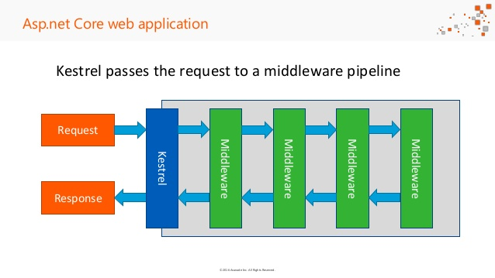
The Pipeline

Slide 6
Middleware
Each middleware Process and manipulates the request as it is received from the previous middleware.
It may decide to call the next middleware in the pipeline or send the response back to the previous middleware ( terminating the pipeline )

Slide 7
The Pipeline
First, the Http Request arrives at the Application
The Kestrel Web server picks up the Request and creates the httpContext and passes it to the First Middleware in the request pipeline
Then the First Middleware takes over, it process the request and passes it to the next Middleware. This chain goes on until it reaches the last middleware
The last middleware returns the request back to the previous middleware, effectively terminating the request pipeline.

Slide 8
The Pipeline
Each middleware in the sequence gets a second chance to inspect the request and modify the response on its way back.
Finally, the response reaches kestrel, which returns the response back to the client
Any of the middleware in the request pipeline can terminate the request pipeline by simply not passing the request to the next middleware

Slide 9
Configuring the Request Pipeline
We need to add the Middleware to the Request pipeline.
This is done in the Configure() method of the Startup class.
The Configure method gets the instance of IApplicationBuilder, using which we can register our Middleware.

Slide 10
Open the Startup class and locate the Configure() method and change the code.
We used the app.Run() method to register our first middleware.
The app.Run() method gets the instance of the Httpcontext.
You can use the Response object from HttpContext to write out some message to HTTP Response

Slide 11


